Slide 1
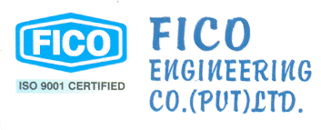

Slide 2
Company History
1952
A registered company; Faizi Industries (Brand Name; FICO), was established by Late Ch.Abdul Aziz, to meet the emergent needs of LV power distribution.
1958
The company became a private limited company, now launching Medium Voltage (MV) power equipment to broaden their scope.
1990
The company was converted into an unlisted public limited company.
1992
Due to replacement of its then management and change in its Board of Directors, its name was change to FICO LIMITED.
1997
Independent divisions were established for quality control & improvement:
2002
Independent Divisions led to 3 independent companies which arises as unregistered FICO GROUP. MV/LV switchboard Division became known as FICO Engineering Co. (Pvt) Ltd.
MV/LV Switchboard
Instrument Transformer
Dropout Cutout
Fuse Switch

Slide 3
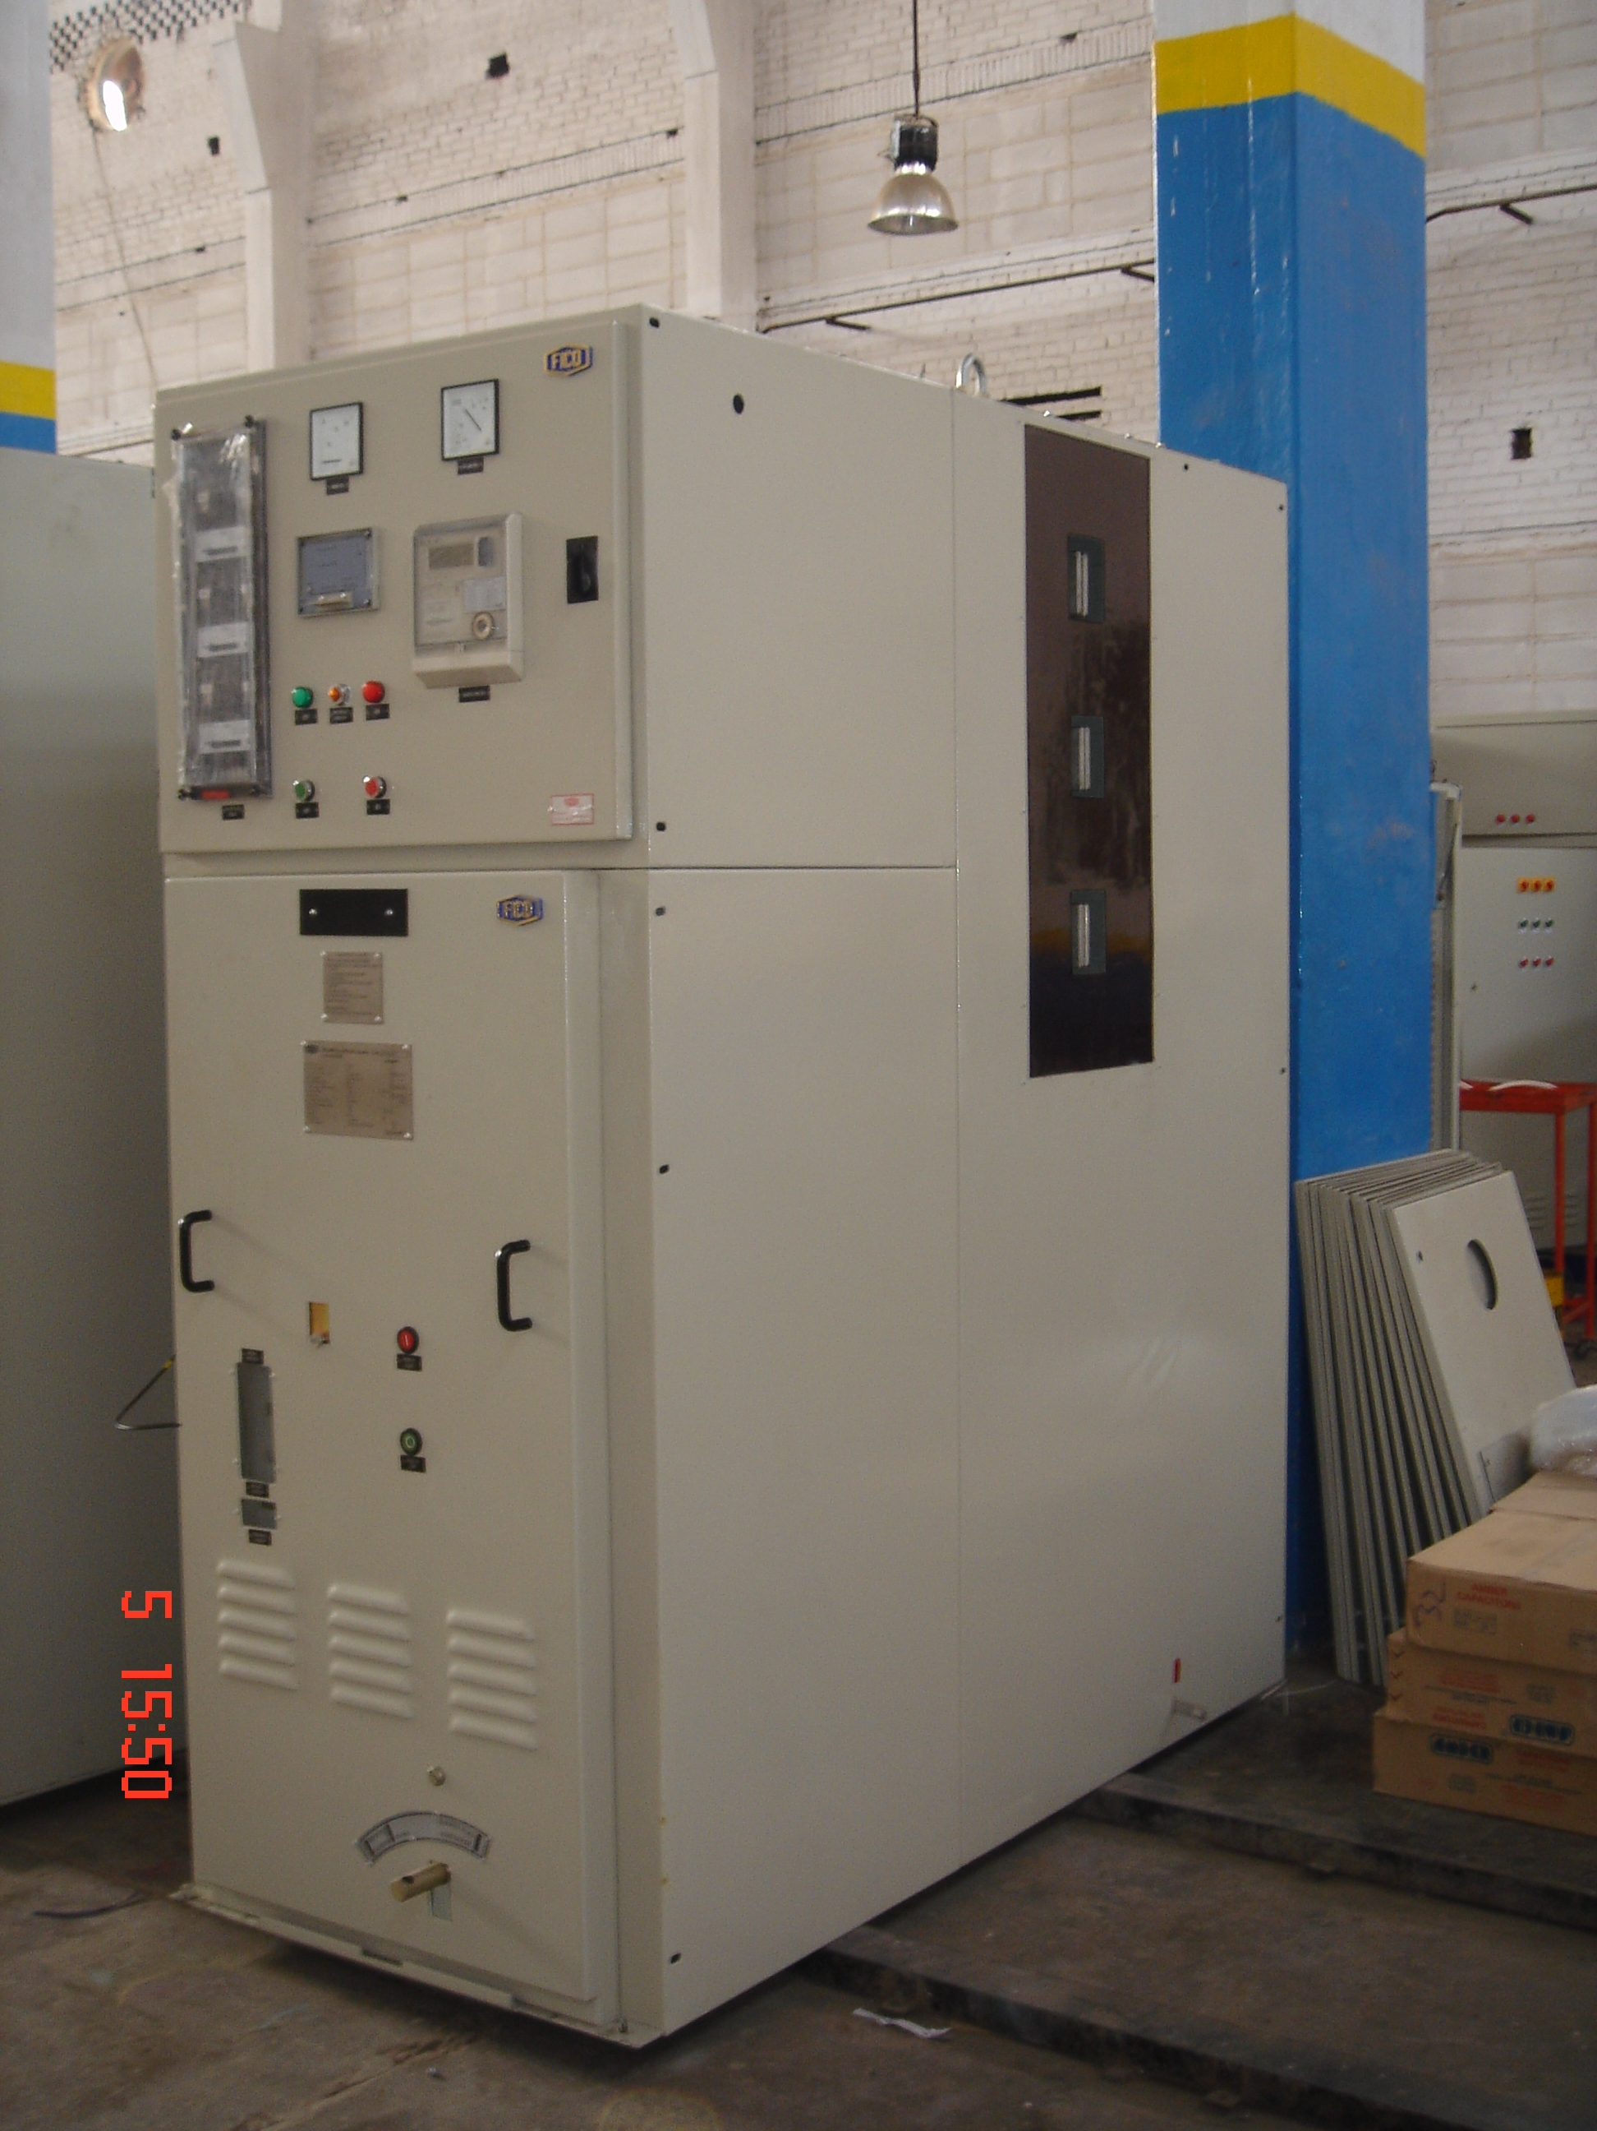
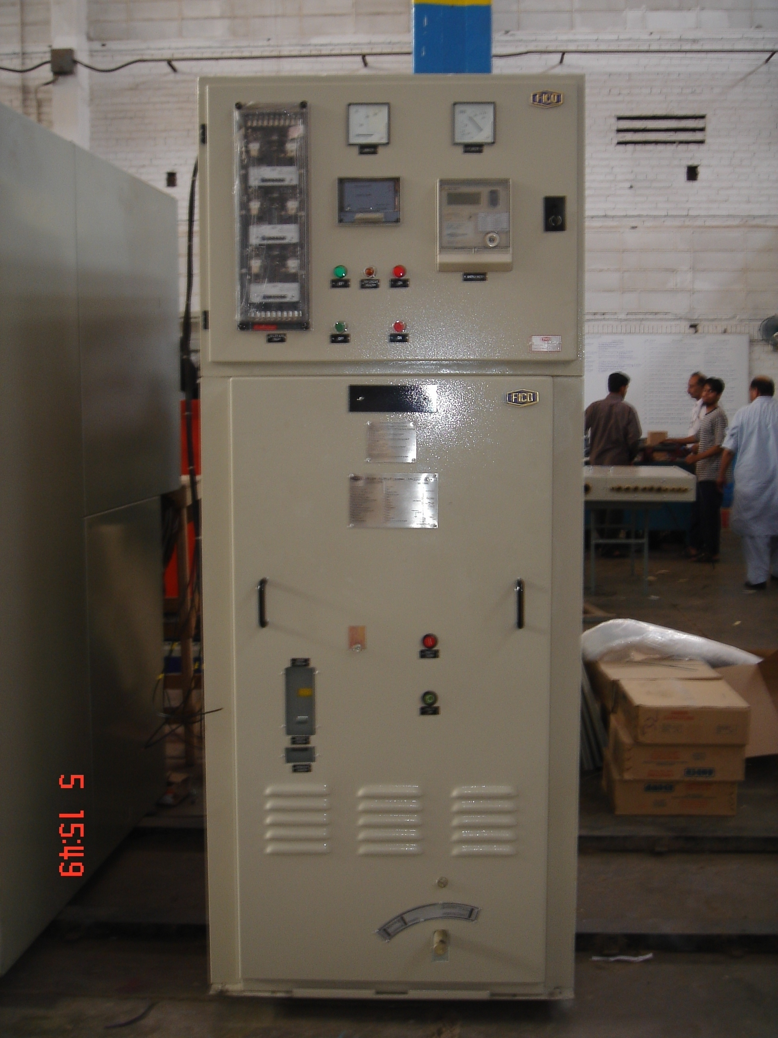
Product Range
MV Switchgear Panels:
1 1 KV Oil Circuit Breaker from HV&S C Lab, Rawat, Pakistan
1 1 KV WAPDA Industrial Panel.
1 1 KV WAPDA Incoming Panel.
1 1 KV WAPDA Outgoing Panel.
1 1 KV WAPDA Bus-Coupler Panel.

Slide 4
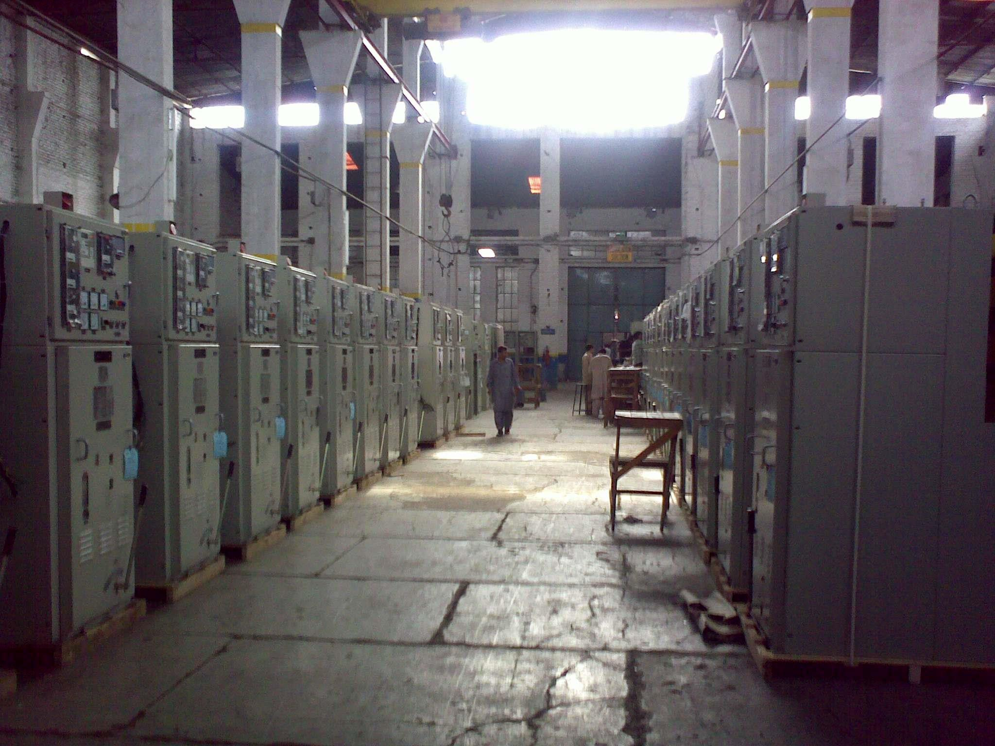
Product Range
MV Switchgear Panels:
1 1 KV Oil Circuit Breaker from HV&S C Lab, Rawat, Pakistan
1 1 KV WAPDA Industrial Panel.
1 1 KV WAPDA Incoming Panel.
1 1 KV WAPDA Outgoing Panel.
1 1 KV WAPDA Bus-Coupler Panel.

Slide 5
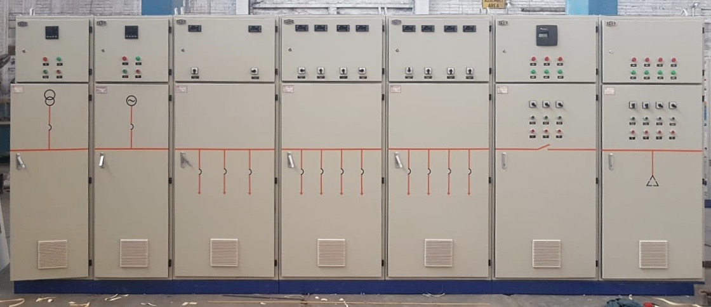
Product Range
LV Switchgear Panels:
LV main Distribution Panel

Slide 6
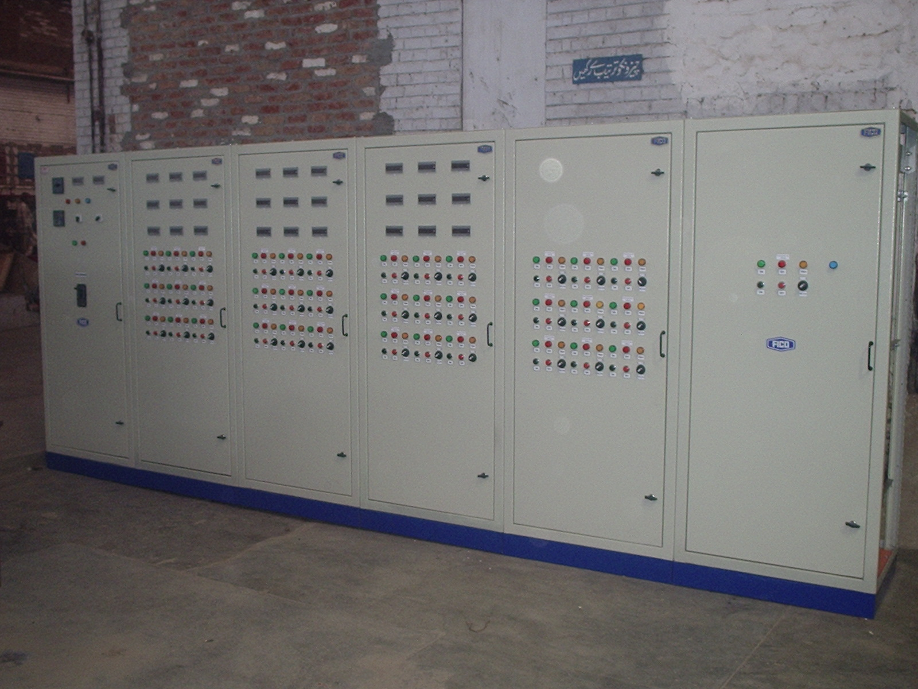
Product Range
LV Switchgear Panels:
Indoor Motor Control Centre (MCC)

Slide 7
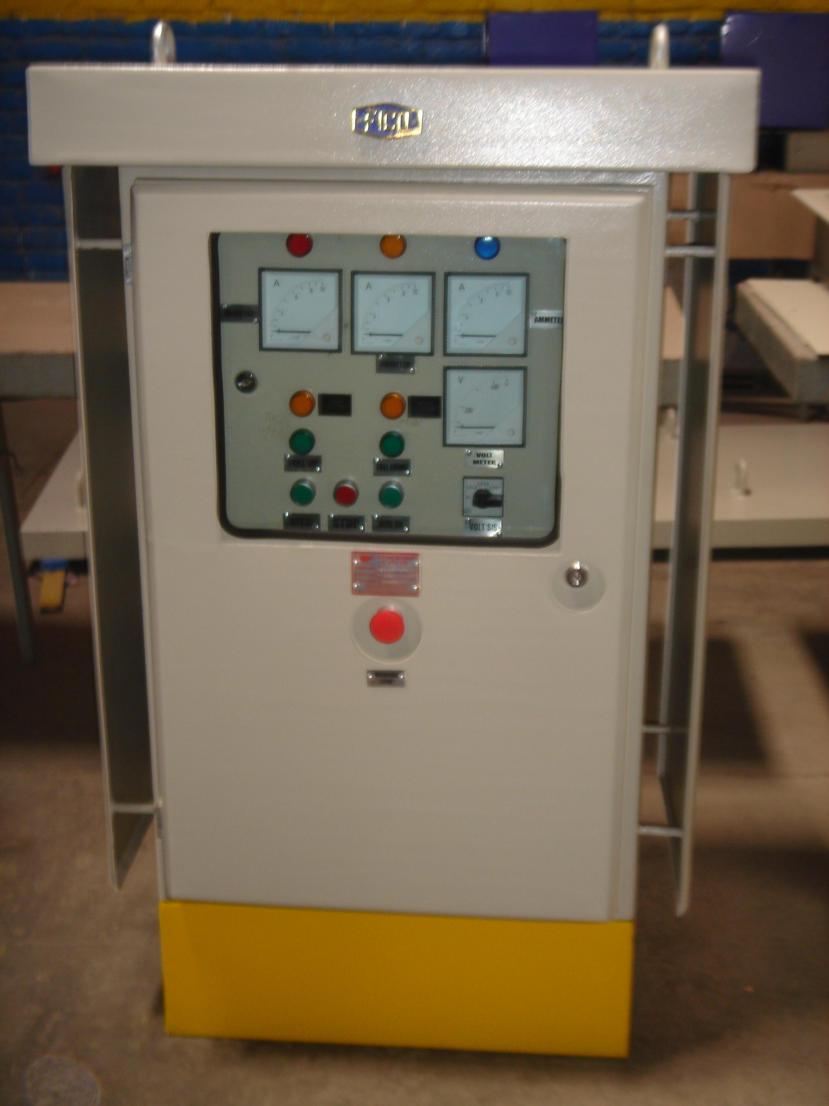
Product Range
LV Switchgear Panels:
Outdoor Motor Control Centre (MCC)

Slide 8
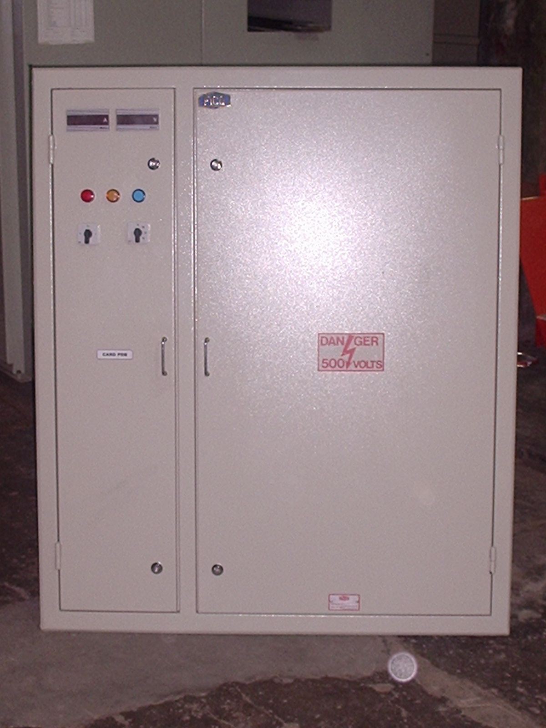
Product Range
LV Switchgear Panels:
Power Distribution Board (PDB)

Slide 9
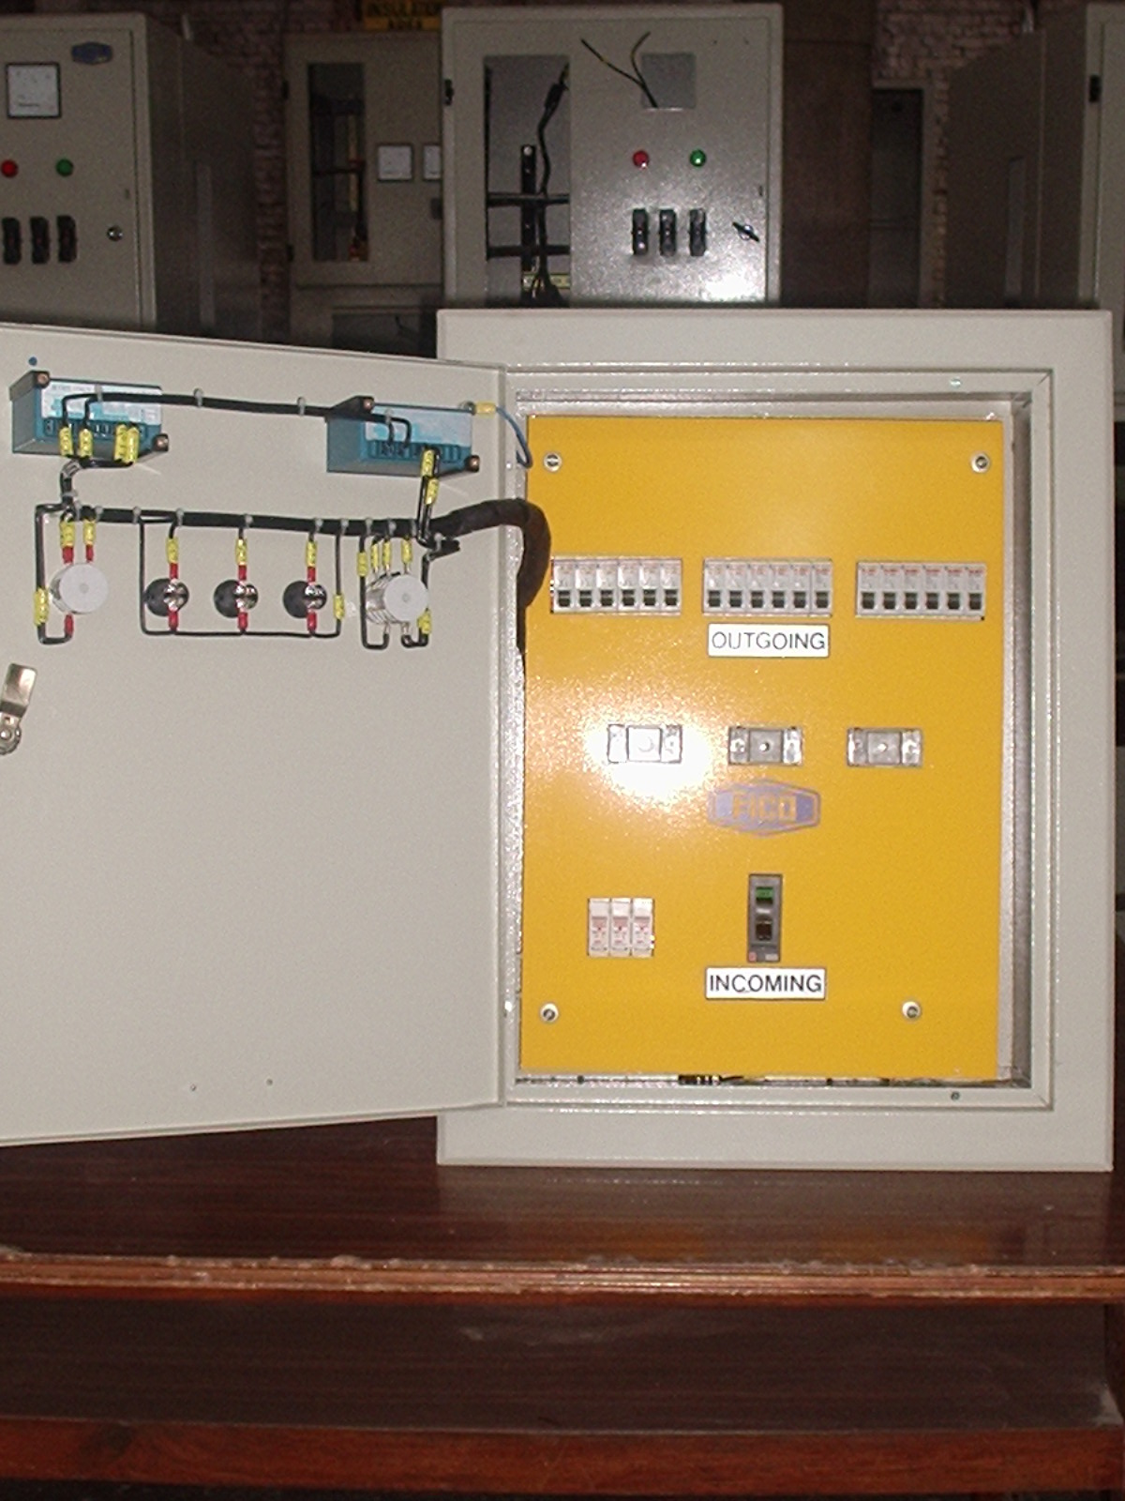
Product Range
LV Switchgear Panels:
Power & Lighting DBs
Product Range

Slide 10
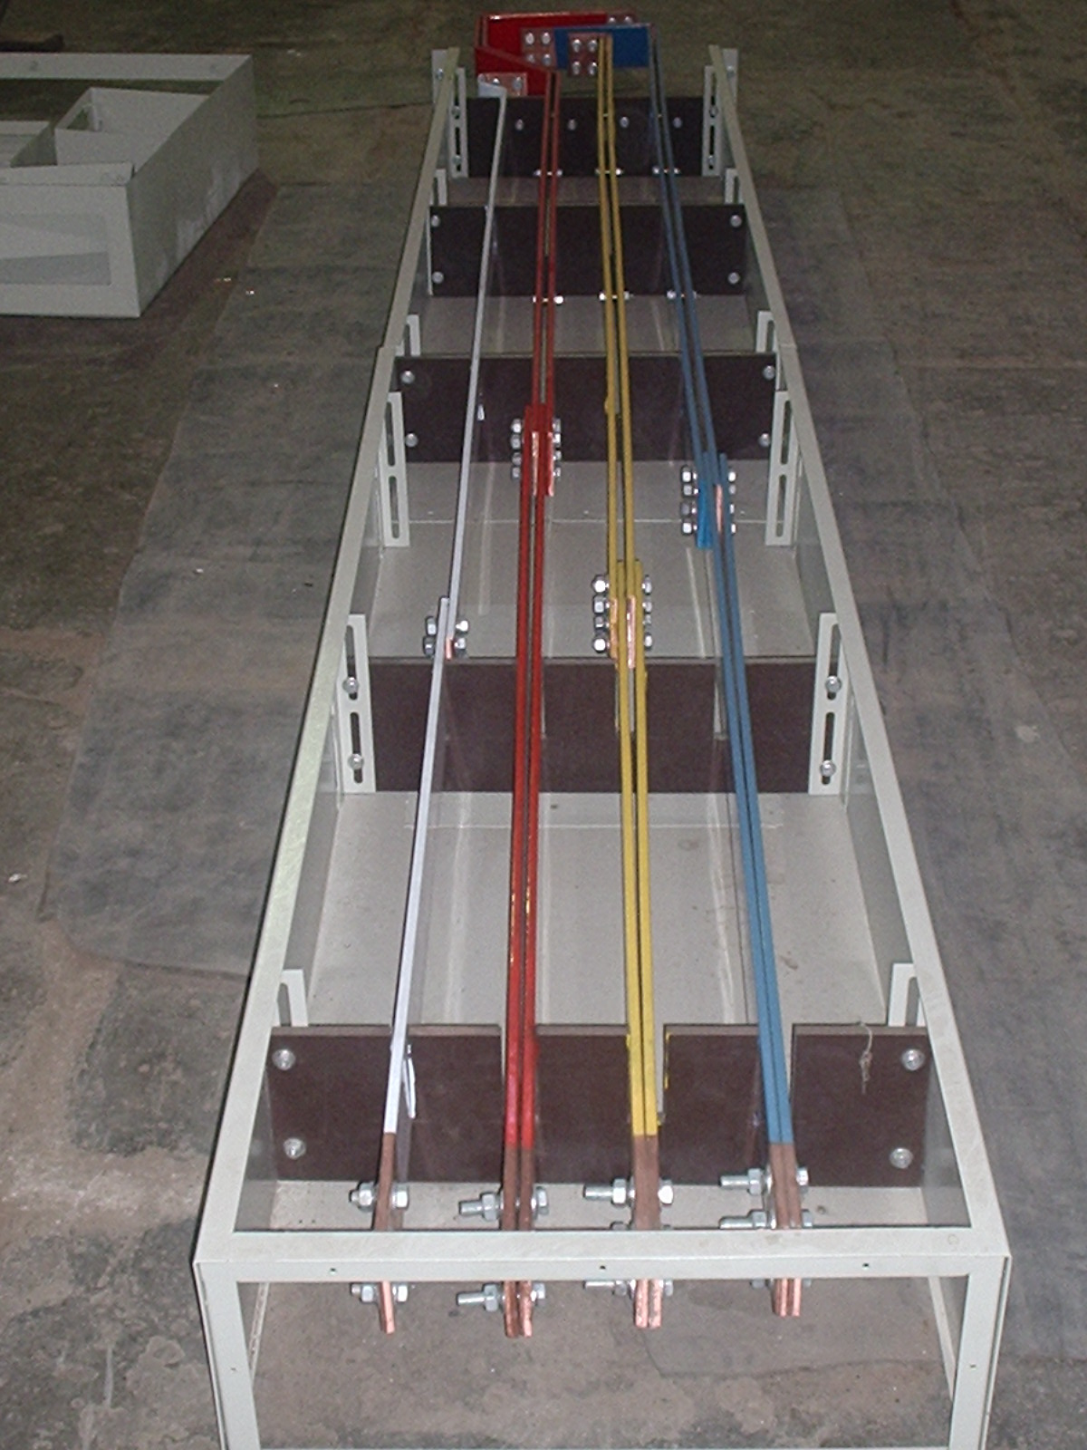
Product Range
Cable & Sleeved Busbar Trunking

Slide 11
Product Range
Interior
Exterior
Kiosks Type Substation

Slide 12
Product Range
Interior
Exterior
MV Ring Main Unit

Slide 13
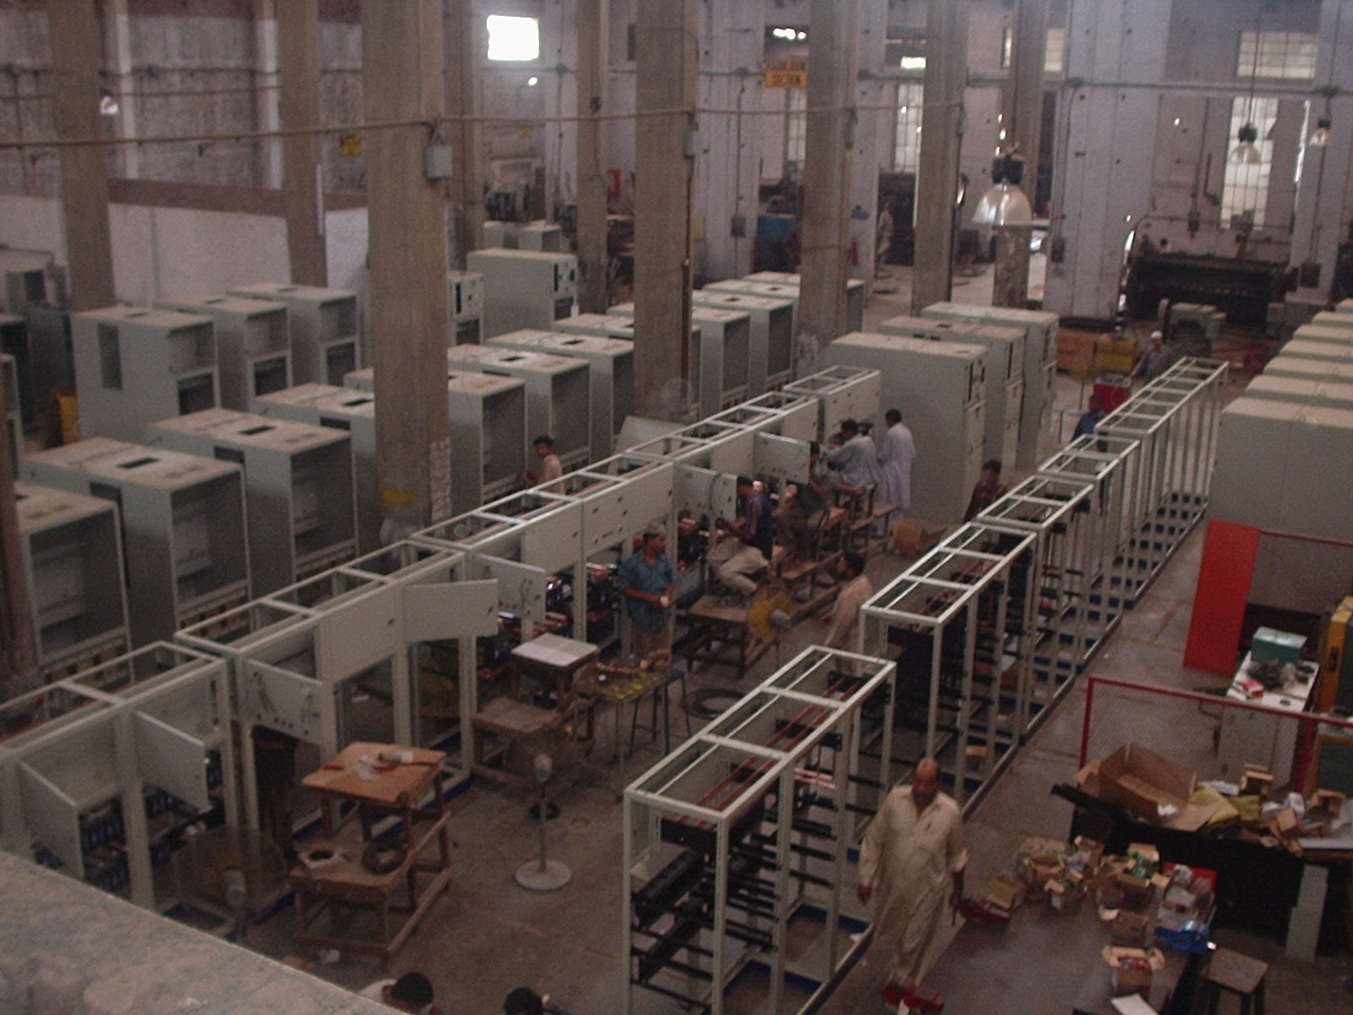
Production Line

Slide 14


